Slide 1

Seminário
IoTDefender: A Federated Transfer Learning Intrusion Detection Framework for 5G IoT
Autor: Marcos Paulo
RA: 173700
Data: 27/10/2022
MO809 - Tópicos em Computação Distribuída
Prof. Luiz Fernando Bittencourt

Slide 2
Sumário
Motivação
Conceitos
Trabalhos Correlatos
Contribuições
Detalhes do IoTDefender
Implementação
Avaliação
Discussão e Conclusão
5G IoT, Mobile Edge Computing(MEC), Intrusion detection, Federated transfer learning
Notes:
In this paper, we propose IoTDefender, the first federated transfer learning framework for IDS of 5G IoT.
In the near future, 5G will be used as infrastructure to connect all walks of life. At the same time, numerous resource-constrained IoT devices make attacks easier and more frequent, resulting in more and more serious harm. 5G needs to provide security for the IoT it carries. 5G IoT security faces three major challenges. First, due to the heterogeneity, diversity and personalization of IoT networks, it is impossible to use a single unified detection model. Second, data in various industries exists in the form of isolated islands so it is hard to share in the light of privacy protection. Third, data island makes some industries produce too little data to train a powerful intrusion detection model. Therefore, 5G needs a personalized,
distributed and effective intrusion detection system that can integrate all IoT information under the premise of protecting the privacy of each IoT data.
IoTDefender carries out data aggregation by federated learning and builds customized detection models by transfer learning. It enables all IoT networks to share information without leaking privacy. Consequently, IoTDefender owns excellent generalization ability, which can highly improve the detection of unknown attacks. The experimental results demonstrate that IoTDefender is more effective (91.93% detection accuracy on average) than traditional method. Furthermore, IoTDefender produces a lower false positive rate than that of a single

Slide 3
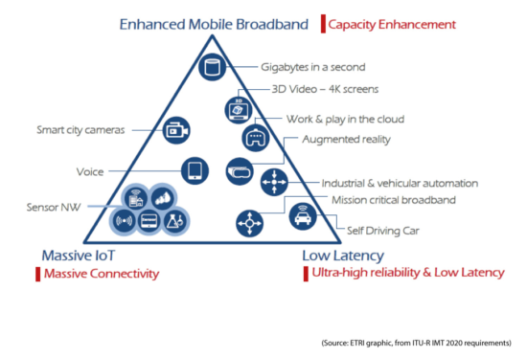
I. Introdução
Expansão do IoT
Aplicações de 5G - eMBB, uRLLC, mMTC
Mobile Edge Computing (MEC)
Intrusion Detection Systems (IDS)
Notes:
5G defines three application scenarios:
Enhanced Mobile Broadband (eMBB), Ultra-reliable and Low Latency Communications (uRLLC) and Massive Machine Type Communications (mMTC).
The latter two scenarios of uRLLC and mMTC are highly related to IoT. Thus, they
can be subsumed under the concept of 5G IoT.
------------------------------------
MEC - Mobile Edge Computing (MEC) pushes the cloud computing capability close to the radio access networks. MEC is an important technology of 5G. It realizes data processing at the edge rather than sending to the cloud. Therefore, MEC can
contribute to 5G in terms of low latency and high reliability.
------------------------------------------
5G, as the infrastructure connecting the IoT needs to provide security measures. An important measure to secure networks is intrusion detection system (IDS).

Slide 4
Mobile Edge Computing (MEC)
I
Processamento massivo de dados rápido e em tempo real.
Segurança de dados e proteção de privacidade
Suporte móvel e de posicionamento para dispositivos IoT
Notes:
MEC can better support 5G IoT for several reasons.
1) Fast and realtime massive data processing. MEC nodes are distributed and close to the device, which makes it more efficient to support local business processing and execution with low latency.
2) Data security and privacy protection. Compared with cloud computing, MEC is able to limit the operation of data within the firewall of edge gateway, and reduce the long-distance transmission of data, thus reducing the risk of data theft and privacy exposure.
3) The mobile and positioning support for IoT devices. For some location-based applications, such as navigation, the terminal equipment can provide relevant
location information and data to the edge nodes for processing, judgment and decision-making, while the request can be responded quickly

Slide 5
Intrusion Detection System (IDS) Desafios
I
5G IoT são sistemas heterogêneos e distribuídos
5G IoT precisa assegurar isolamento de dados e privacidade.
Dispositivos IoT com pouca quantidade de dados para treinamento
Notes:
The IDS for 5G IoT faces the following three challenges:
1-5G IoT is a geographically distributed, heterogeneous and hierarchical system, which requires personalized models
instead of a single unified model. An unified IDS model is not practical and personalized models should be suggested. Due to the existence of MEC and its strong support for IoT, the IDS in 5G IoT should be deployed in a distributed and hierarchical manner.
2-5G IoT needs to ensure data isolation and privacy. Data privacy has always been an important issue for the security field. Due to security and privacy issues, data often exists in the form of isolated islands.
Although a large quantity of data exists in different networks, it is impossible to collect, integrate and use them. we need to study the IDS model of 5G IoT, which can integrate the information from all IoTs under the condition of protecting the privacy of user data.
3-the small amount of data leads to inefficient training model. some IoT devices generate little traffic, which is often triggered by infrequent user interaction, such as in intelligent parking, remote meter reading, etc. it is difficult for the IDSs to find unknown attacks when new attacks occur.

Slide 6
Contribuições
I
1º framework de federated transfer learning para IDS em 5G IoT
Framework Hierárquico, flexível e extensível
Testes com redes de dispositivos reais
Privacidade de dados preservada e boa performance
Notes:
To solve the aforementioned problems, a novel intrusion detection system based on federated transfer learning is proposed in this paper.
Federated transfer learning enables different enterprises or institutions to train their own personalized models by learning knowledge from each other without sharing them directly.
On the Security Cloud side, IoTDefender aggregates the information from MEC platforms without leaking privacy by federated learning. On the MEC side, IoTDefender trains personalized models by transfer learning, detects abnormal traffic and sends alerts to specific IoT network within its coverage area.
1-To the best of our knowledge, IoTDefender is the first framework to apply federated transfer learning to the IDS of 5G IoT. It aggregates data from different IoT networks securely and achieves a good detection model for each IoT network through knowledge transfer and federation.
2-Our framework is hierarchical, flexible and extensible, which can be easily used in many different IoT network.
3-It utilizes federated learning to aggregate information and ensure data privacy of each IoT network.
4-It utilizes transfer leaning to achieve personalized model for each IoT network.
5-With federated transfer leaning, IoTDefender has strong generalization ability and can detect unknown attacks effectively.
6 - We conduct extensive experimental analysis using both private and public datasets to simulate the heterogeneous IoT environment in the real world.
We conduct extensive experimental analysis using both private and public datasets to simulate the heterogeneous IoT environment in the real world. The private datasets are from two different smart home networks, one smart camera monitoring network and one traditional network respectively.
7 - With the data privacy well preserved, we achieve a good performance of intrusion detection with an increase of about 3.13% compare to traditional ML methods.

Slide 7
II. Trabalhos Correlatos - IDS
Inflexível e difícil de estender
Restringido por protocolos
Aplicado apenas a alguma aplicação IoT específica
Notes:
These solutions focus on routing attacks inside the wireless sensor network, which are constrained by protocol and only applicable to some specific IoT.
In contrast, IoTDefender is intrusion detection system deployed outside the radio network, which is general and does not oriented to any specific protocol.
The above approaches rely on clustering large numbers of packets to detected intrusions in a centralized way. They not only require a lot of computing resource, but also are inflexible and hard to extend. As a matter of fact, 5G IoT systems are mostly distributed in different regions and industries, and each IoT has its own traffic and business characteristics. Therefore, the distributed, personalized, flexible and scalable IDS has an important application prospect. Fortunately, fog computing and edge computing can help us achieve this goal.
Several methods proposed the IDS mechanism for IoT using distributed architecture based on fog computing nodes and ML. The distributed mechanism
respects security, interoperability, flexibility, scalability and heterogeneity aspects of IoT systems. However, due to data privacy, the above distributed methods can hardly help different networks to share knowledge securely. Also,they can hardly reflect the situation of the real world because all of them use only one IDS dataset like NSL-KDD for experiment.
we need to design an IDS framework which can integrate the data of various industries on the premise of protecting the privacy of users. IoTdefender uses federated transfer learning to achieve this goal.

Slide 8
Trabalhos Correlatos - Federated Learning
II
DioT
Limitações:
Usa um modelo de arquitetura unificado que não considera modelos de IoT personalizados
Dificilmente detecta ataques novos ou desconhecidos
Notes:
Federated learning was first proposed by Google in 2016 [36]. Its design goal is to carry out efficient learning among multiple participants or computing nodes on the premise of ensuring the information security during data exchange, protecting
personal data privacy, and ensuring legal compliance. Federated learning is able to solve the data island problems effectively.
Federated transfer learning, which is applicable to the scenarios where two datasets are different not only in samples but also in feature space. The IoTDefender belongs to federated transfer learning category.
In the field of IDS system of IoT, Thien Duc Nguyen presents the DÏoT.
DioT is a Self-learning distributed system that first applies federated learning to aggregate behavior profiles for detecting device type specific anomaly autonomously
DioT Limitations:
1-Both the Security Cloud and security gateway use a unified model architecture without considering the needs of personalized IoT models
2-DÏoT lacks the support of public datasets (the model is random at the beginning), so it hardly detects new or unknown attacks.

Slide 9
Transfer Learning
II
Transferir conhecimento de um domínio existente para um novo domínio
Resolve treinamento de modelos com poucos dados
Ainda não foi aplicado na segurança da rede
Sua combinação com aprendizado federado pode quebrar as barreiras de dados entre organizações
Notes:
Transfer learning aims at transferring knowledge from existing domains to a new domain without rebuilding models. which is used to solve the problem that the model cannot be effectively trained because of the small data island.
Transfer Learning has not been applied in network security.
IoTDefender can make use of domain adaptation to solve the issue of different distribution between traditional network and IoT.
The combination of federated learning and transfer learning can break the data barriers between different organizations. Several researches on federated transfer learning have been discussed but not for attack detection in 5G IoT.

Slide 10
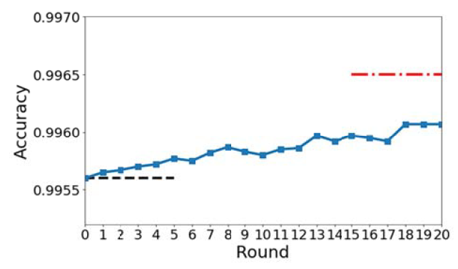
III. Definição do problema
Proteger a privacidade de diferentes dados de rede IoT em vez de compartilhá-los diretamente
Melhorar o desempenho do Modelo IoTDef muito além do modelo individual M-TRA (modelo personalizado)
garantir sua precisão o mais próximo possível do M-UNI (modelo unificado)
Muni
Mtra
Notes:
In IoTDefender, we combine N different MEC platforms to get traffic data from the edge of the 5G IoT network. In our problem, we want to protect the privacy of different IoT network data rather than directly sharing them. In addition, we need a model that can better adapt to the local network environment and owns generalizition ability to detect unknown attack.
We want to collaborate all the data to train the federated transfer model M-IoTDef while any MEC platform (Pi) will not disclose their data Di to each other.
The goal of IoTDefender is to establish a collaborative framework to improve the performance of M-IoTDef beyond individual model M-TRA(personalised model) and ensure its accuracy as close as possible to that of M-UNI(Unified model).

Slide 11
Overview do framework
III
3 camadas
Nuvem de segurança
Plataformas MEC
Dispositivos IoT
Notes:
IoTDefender aims to achieve excellent detection accuracy through federated transfer learning and ensuring data security.
We assume that there are three MEC platforms as the clients of federated learning and one Security Cloud platform as the server, which can be extended to more general situations. The overall architecture of IoTDefender is shown in Fig. 1.

Slide 12
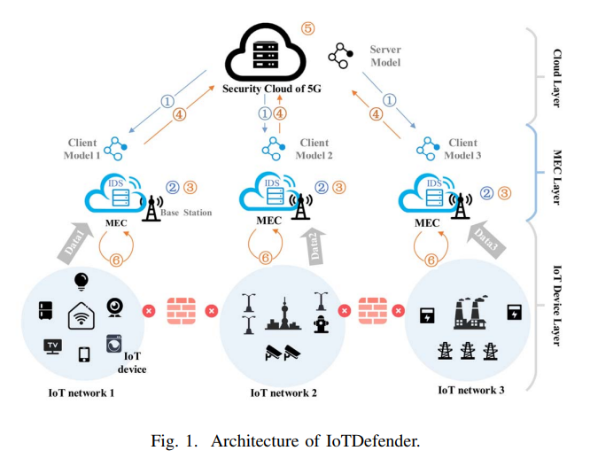
III
Notes:
IoTDefender framework has three layers.
The top layer is Security Cloud platform operated by 5G operator which owns a large amount of data and computing resource to train the server model.
The Security Cloud is different from IoT cloud platform in that it integrates all IoT security detection information within its coverage and can be worked as a part of 5G security infrastructure.
The bottom layer is IoT devices layer with a variety of intelligent IoT endpoints.
Note that different IoT networks are distributed at different locations and
do not share information with each other.
IoTDefender should have capability to store and process data from all the sensor networks and should provide quick response in a short time.

Slide 13
Model Training
III
1- Modelo do servidor é treinado com o dataset público e distribuído para todos os MEC
2- Cada MEC treina seu modelo de cliente com seu dataset local privado. (Transfer Learning)
3- Cada MEC computa o “logits” de cada modelo cliente com base no dataset público como entrada.
4- Cada MEC faz o upload de “logits” para a nuvem de segurança
5- O servidor integra eles, e transmite o novo “logit” para os clientes MEC.
6- Cada MEC treina um modelo de cliente novamente no conjunto de dados públicos por algumas épocas para obter um modelo de cliente personalizado.
7- Repete etapas 3 a 6 até a convergência
Notes:
1- The server model is trained according to the public IDS dataset and distributed to all MEC platforms.
2- Each of MEC platforms can train their client model based on their local private IDS data. In this step, the data distribution between the Security Cloud and MEC platforms is different. Transfer learning is performed to make the client model customized for each IoT.
3- Each MEC platform computes the logits of client model based on the public dataset as the input. **Note that the logits indicate the output result of the layer before softmax layer**
4- MEC platforms upload the logits to the Security Cloud.
5- The server integrates them and transmits the new logits to MEC clients.
6- Each MEC client trains client model on public dataset to make its logits approach to the new logits. After that, each of them trains client model again on private dataset for a few epochs to get a personalized client model.
The step 3 to 6 procedures are repeated throughout the training process.
Note that all the steps do not disclose any user data or information.
After the training process is completed, the personalized IDS model generated in the final transfer learning process is used to detect intrusion.
Security Cloud have highly different probability distribution and feature spaces with the samples in each MEC platform. Therefore, transfer learning is applied to local IoT network to construct a pesonalized client model.
The federated learning paradigm is the basic computing model of IoTDefender. It deals with model building and knowledge sharing without leaking privacy during the whole process. After the server model is generated, it cannot be directly applied to the clients IoT, since it is obvious that the samples in the Security Cloud have highly different probability distribution and feature spaces with the samples in each MEC platform. Therefore, transfer learning is applied to local IoT network to construct a pesonalized client model.

Slide 14
Model Training - Federated Learning
III
Resolve problema de isolamento de dados
Etapas:
-Aprendizado do modelo de servidor
-Aprendizado do modelo cliente
Notes:
IoTDefender adopts the federated learning to resolve the problem of data isolation.
This step mainly consists of two critical parts: server and clients model learning.
In Security Cloud side, the server trains the server model based on public dataset and sends the initialized server model parameters to clients. In MEC side, each client trains its client models based on the sever model and private dataset.
Then, the clients upload their updated parameters like weights or gradients to the server for aggregation. In this paper, the clients upload logits to the server [35]. During aggregation, the server aligns all clients parameters. It can perform an average operation to get new parameters. And the updated parameters are returned to the clients, each client starts the next iteration. The above
procedure will be repeated until the whole training process converges.
For each MEC platform, the client model has a good generalization ability, since it integrates the knowledge from both the Security Cloud and all other MEC platforms in an implicit way.

Slide 15
Model Training - Transfer Learning
III
Resolve o problema de privacidade de dados, isolamento de dados e de heterogeneidade dos dados do modelo servidor e de cliente.
Usado após gerar o modelo de servidor para criar um modelo cliente utilizável em dispositivos IoT
Dados públicos: Redes tradicionais
Dados privados: Dados da rede IoT
Notes:
Federated learning has solved the issue of data privacy and data islands. Another important issue is data heterogeneity. If we directly apply the sever model to clients, it still performs poorly due to the great distribution difference between the MEC and the cloud data.
In addition, the sever model in the Security Cloud only learn the coarse features from the large dataset of traditional network, whereas fail to learn the finegrained
information of a particular IoT network. It has been proved that in deep neural networks, features in the lower levels are highly transferable since they focus on learning common and low-level characteristics. The higher layers will learn more specific features to the task [30]. Therefore, after obtaining the server model, MEC clients can perform deep transfer learning to achieve personalized client model.

Slide 16
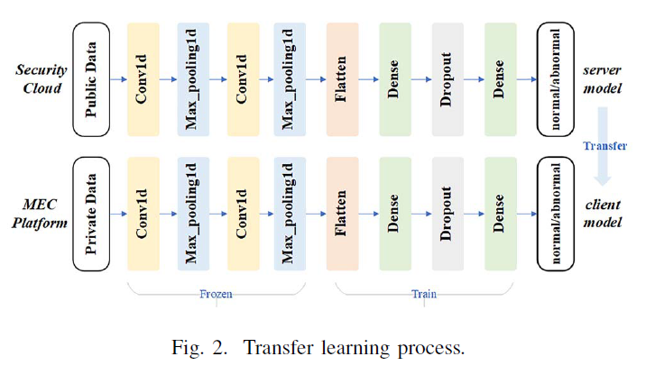
Neural Network
III
2 redes convolucionais
Input: Dados de rede
Output: Classes de tráfego (Normal ou anormal)
Fine Tuning
Parâmetros ajustáveis
Notes:
The transfer learning process is shown in the Fig. 2. The neural network consists of two convolution layers (conv1d, conv2d), two maximum pool layers (max_pooling1, max_pooling2), two full connection layer (Dense), one flatten layer (Flatten) and one dropout layer (Dropout). The input is network data and outputs are traffic class (normal or
abnormal).
We regard that the lower layer will extract the basic features of network traffic, while the higher layer will extract the special features of network traffic.

Slide 17

Learning Process
III
Adaptação de domínio
Maximum Minimum Variance (MMD) para calcular diferença entre datasets
Quanto maior MMD maior a diferença entre datasets
Soma a distância MMD com a perda de treinamento de classificação(Lc) para obter a função de perda
Loss Function
Xs e Xt = Domínios de origem(source) e destino(target)
λ = balanço do peso do MMD
Notes:
In our task, we have large public dataset from traditional network as source domain and private data from IoT network as target domain. IoTDefender adopts domain adaptation(aim at learning from a source data distribution a well performing model on a different (but related) target data distribution) to solve the problem that the probability distribution of source domain and target domain is inconsistent [28].To this end, we borrow the idea from [27] called DDC. In order to measures the distance between two domains, a kernel learning method called maximum mean variance (MMD) is used. The greater he MMD value, the greater the difference between the two datasets.
We add this distance to the loss of the network for training, and then get the loss function

Slide 18
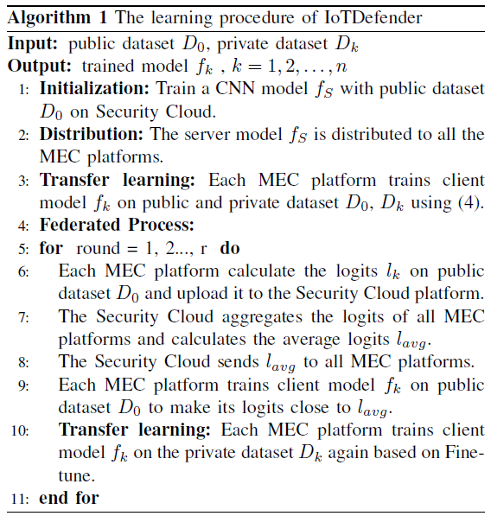
Algoritmo
III

Slide 19
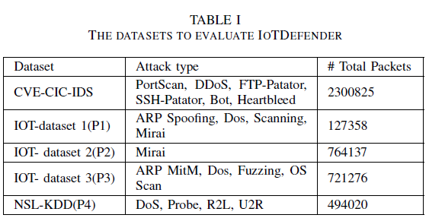
IV. Experimentos
Smart Home
Smart Home (9 aparelhos)
8 Câmeras de vigilância
CVE-CIC-IDS e NSL-KDD = datasets públicos
IOT Datasets = datasets privados
Notes:
In this section, we evaluate the performance of the proposed IoTDefender via two experiments on known and unknown attacks detection.
We use CICIDS2017 as public dataset, NSL-KDD and three IoT datasets as private dataset.
The remaining three IoT datasets are drawn from three different real IoTs, two of which are smart home networks denoted as P1 and P2 respectively, and the other is IP cameras video surveillance network denoted as P3.

Slide 20
Implementação
IV
Uso de CNN, 60% de dados para treinamento, learning rate = 0.1, batch size=64, épocas de treinamento = 10. Experimentos simulados 5 vezes e computado a média dos valores.
Experimento 1 - habilidade de detecção de ataques
Experimento 2 - habilidade de generalização
Comparação de performance entre:
Métodos tradicionais de ML (KNN, Adaboost, Random Forest, CNN)
Modelo somente com TF
Modelo somente com FED - Conceito do DIoT
Notes:
We conduct two experiments to evaluate the effectiveness of IoTDefender.
The first experiment is to evaluate the basic ability of attack detection, and the second is to prove the generalization ability.
On both Security Cloud and MEC platforms, we design the IDS models based on convolutional neural network (CNN) because deep neural network can
learn nonlinear characteristics of data and is easy to perform knowledge transfer. The CNN network is shown in Fig. 2.
we use 60% of each dataset for training and 40% for testing. We set the learning rate of batch processing to 0.1, the batch size to 64 and the training epochs to 10.
In order to verify the effectiveness of IoTDefender (IoTDef),we compare its performance with traditional ML method, such as KNN, Adaboost (AB), Random Forest (RF) and CNN in the first experiment.
Also with transfer learning only (TF), in which the server model is retrained by local data, without federated learning. And federated learning only (FED), which means it do not perform transfer process.

Slide 21
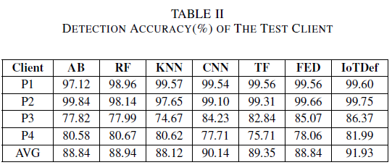
Resultados Detecção Acurácia
IV
Acurácia na classificação de ataques nos clientes
Notes:
TP is true positive indicating the quantity of attack samples correctly detected,
TN is true negative indicating the quantity of normal samples correctly detected,
FN is false negative indicating the quantity of attack samples incorrectly detected
FP is false positive indicating the quantity of normal samples incorrectly detected.
In a word, IoTDefender is effective to detect anomaly.

Slide 22
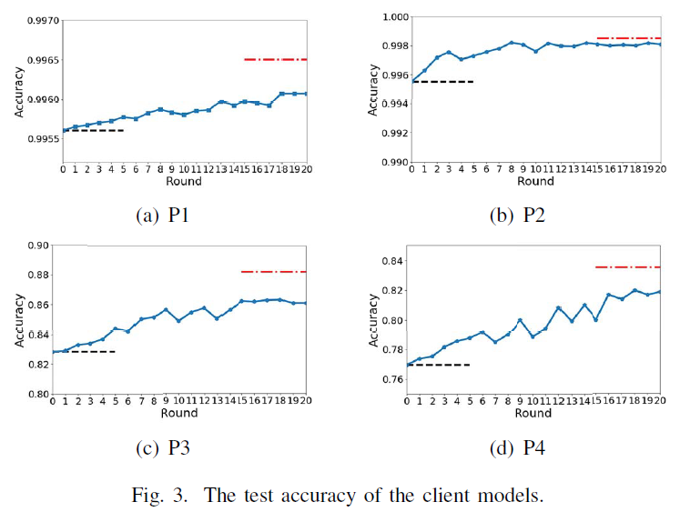
Resultados Detecção Acurácia
IV
Linha Vermelha (ideal) - Dataset público + Todos os datasets privados
Linha preta (mínimo) - Dataset público + dataset privado individual
Muni -Unified Model
Smart Home 1
Smart Home 2
Câmeras de segurança
NSL-KDD
Notes:
Fig. 3 shows the test accuracy of IoTDefender of iteration rounds. The black dashed line (on the left) represents the test accuracy of a model after transfer learning with the public dataset and its own private dataset. It is the lower limit of IoTDefender. The red dash-dot line (on the right) represents the would-be performance of a unified model MUNI based on the whole datasets (including public and all private datasets). It is also the upper bound of IoTDefender. After several rounds of learning, the accuracy of IoTDefender is almost close to its upper bound.
For example, it reaches 99.8% of the upper limit in P2. In fact, IoTDefender trades a small loss of accuracy for data privacy protection.

Slide 23
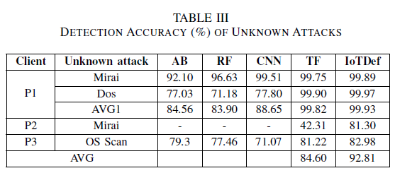
Resultados do modelo generalizado
IV
Capacidade do modelo detectar ataques desconhecidos com ajuda do dataset público
Remove o ataque do dataset de treino de 1 dos clientes, mas mantém no demais clientes e no dataset de teste.
*Em P2: O dataset público não contém dados do Mirai. TF usa o modelo de servidor e o IoTDef os dados de P1 e P3
Notes:
In order to prove the superiority of the generalization ability of the federated transfer learning model, we set up another experiment to verify that IoTDefender can not only detect the attacks contained in local training dataset, but also identify unknown attacks with the help of the public and other local datasets.
We first remove the data of some certain attacks in training set and maintain them in test set. Specifically, we remove Mirai and Dos from P1 training set while keeping other data sets unchanged, but keep them in test set. Similarly, we remove Mirai from P2, OS Scan from P3 in training set and maintain them in test set.
Then, we repeated the previous experiment as mentioned in last subsection.
Finally, we compare the detection accuracy of the unknown attack of IoTDefender with other models.
We run the two experiments 5 times to record the average values.
If there is no Mirai attack at the P1 training set, traditional models cannot learn the behavior of Mirai attack. So they hardly recognize it when Mirai attack appears in the network for the first time. However, IoTDefender utilizes federated transfer learning to help P1 learn the knowledge of Mirai from P2 and public dataset implicitly. Therefore, even P1 owns
few data, it can detect new attacks that never occured before, and the result proves that.
As shown in the Table III, the unknown attacks detection accuracy of TF is higher than that of traditional models, while the accuracy of IoTDefender is higher than that of all other models. TF can use the large public dataset so it performs better. Compared with TF, IoTDefender produces higher accuracy with 8.21% improvement. This fully proves that IoTDefender has strong generalization ability.

Slide 24
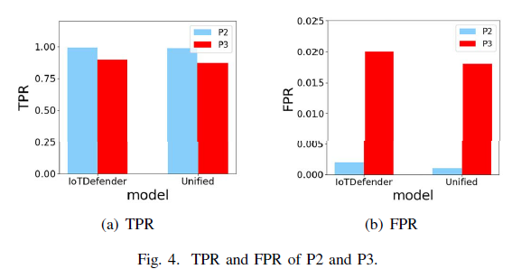
Comparação com modelo unificado
IV
*FPR do IoTDefender é menor, e a acurácia e o TPR de uma rede unificada é maior
Notes:
In addition, due to the heterogeneity of datasets, utilizing a unified model MUNI or only federated learning model MFED is more likely to suffer from increasing false positive rates or decreasing sensitivity of the model. IoTDefender can overcome these defects since it builds a personalized IDS model for each IoT network through transfer learning.
Each client model focuses on the characteristic behavior of one single IoT, resulting in a more specific, accurate and personalized IDS model. In order to evaluate the benefit of using personalized models, we compared IoTDefender with the unified model MUNI by means of accuracy, TPR and FPR.
The results in Fig. 4 indicate that IoTDefender has lower FPR although it does not do well as MUNI in TPR and accuracy (Fig. 3). Therefore, IoTDefender has advantages
on personalization which makes it more practical to deploy in real world.

Slide 25
V. Discussão e Trabalhos Futuros
Quais clientes selecionar os para o aprendizado federado(5G Slice)
Aplicar métodos para assegurar a qualidade da comunicação e evitar perdas. Reduzir número de rodadas.
Treinar dados de tráfego de rede online com método de aprendizado incremental para prevenir ataques completamente novos à rede.
Notes:
1- In the IoTDefender implementation in this paper, we just build four client IoTs for the federated learning process. With more and more clients joining the system, how to choose the federated clients is an important problem. There is no need to choose all the clients in federate process. A potential way is to combine the information of 5G slice. The networks under the similar slice could be a group of federated clients.
2- Due to the issue of slow network speed in some 5G IoT areas, it is difficult to ensure reliable communication. The possible methods, like compression scheme and local update, can be used to optimize the federation algorithm. They are able to reduce the communication rounds and make the transmission parameters as small as possible to ensure the transmission quality.
3- With the development of attack technology, the attack mode is also constantly changing. Original dataset is out of date and new knowledge is required. It is possible to train network traffic data online with incremental learning method to make the model more powerful.

Slide 26
VI. Conclusão
Manutenção da privacidade e segurança dos dados
Framework de transferência de aprendizado federado para segurança de IoT 5G
Detecção de pacotes maliciosos com 91,93% de precisão
Habilidade de generalização
Notes:
In this paper, we propose IoTDefender, a novel intrusion detection framework based on federated transfer learning for 5G IoT security.
IoTDefender captures network traffic from different IoT networks, processes it on the MEC platform and obtains personalized detection models without disclosing data and privacy.
Experiments demonstrate the effectiveness and validity of IoTDefender by detecting malicious packets with 91.93% accuracy on average.
The generalization ability is also proved by its significant accuracy increase for unknown attacks detection when compared with other methods.

Slide 27
Novos trabalhos
D¨IOT: A Federated Self-learning Anomaly Detection System for IoT [2019]
Primeiro sistema a empregar uma abordagem de aprendizado federado para detecção de intrusão baseada em detecção de anomalias
- Altamente eficaz (taxa de detecção de 95,6%)
- Rápido (≈ 257 ms)
- Não requer nenhuma intervenção humana ou dados rotulados para operar.
Local Differential Privacy-Based Federated Learning for Internet of Things [10-2020]
- Internet dos Veículos (IoV).
- Evitar a ameaça à privacidade e reduzir o custo de comunicação
- Propõe quatro mecanismos de privacidade diferencial local (LDP) para perturbar gradientes gerados por veículos
- Uso intensivo de dados experimentais.
Notes:
D¨IOT: A Federated Self-learning Anomaly Detection System for IoT [2019]
DIOT is the first system to employ a federated learning approach to anomaly-detection-based intrusion detection, highly effective (95.6 % detection rate) and fast (≈ 257 ms) at detecting devices compromised. It does not require any human intervention or labeled data to operate. It learns anomaly detection models autonomously, using unlabeled crowdsourced data captured in client IoT networks.
Local Differential Privacy-Based Federated Learning for Internet of Things [10-2020]
The Internet of Vehicles (IoV) is a promising branch of the Internet of Things. To avoid the privacy threat and reduce the communication cost, in this article, we propose to integrate federated learning and local differential privacy (LDP) to facilitate the crowdsourcing applications to achieve the machine learning model. Specifically, we propose four LDP mechanisms to perturb gradients generated by vehicles.
We further propose a suboptimal mechanism (PM-SUB) with a simple formula and comparable utility to PM-OPT. Then, we build a novel hybrid mechanism by combining Three-Outputs and PM-SUB. Finally, an LDP-FedSGD algorithm is proposed to coordinate the cloud server and vehicles to train the model collaboratively. Extensive experimental results on real-world data sets validate that our proposed algorithms are capable of protecting privacy while guaranteeing utility.

Slide 28
Novos Trabalhos
Federated Deep Learning for Zero-Day Botnet Attack Detection in IoT-Edge Devices [06-2021]
O método tradicional de DL centralizado (CDL) não pode ser usado para detectar o ataque de botnets anteriormente desconhecidos (dia zero) sem violar os direitos de privacidade de dados dos usuários. O artigo, propõe o método DL federado (FDL) para detecção de ataque de botnet desde o dia zero para evitar vazamento de privacidade de dados em dispositivos IoT-edge.
Notes:
Federated Deep Learning for Zero-Day Botnet Attack Detection in IoT-Edge Devices [06-2021]
The traditional centralized DL (CDL) method cannot be used to detect the previously unknown (zero-day) botnet attack without breaching the data privacy rights of the users. In this article, we propose the federated DL (FDL) method for zero-day botnet attack detection to avoid data privacy leakage in IoT-edge devices.

Slide 29
Novos Trabalhos
Internet of Things Intrusion Detection System based on Transfer Learning [05-2022]
Ao contrário do trabalho anterior na extração de recursos projetados manualmente, esse método mantém o desempenho de aprendizado de ponta a ponta do Deep Learning (DL), reduz o risco de migração de conceito e reduz a intervenção humana.
FL-Defender: Combating Targeted Attacks in Federated Learning [07-2022]
Neste artigo, são analisados ataques direcionados contra FL e deles os autores descobrem que os neurônios na última camada de um modelo de aprendizado profundo (DL) que estão relacionados aos ataques exibem um comportamento diferente dos neurônios não relacionados, tornando os gradientes da última camada recursos valiosos para detecção de ataques. O FL-Defender atinge as menores taxas de sucesso de ataque, mantém o desempenho do modelo global na tarefa principal e causa sobrecarga computacional mínima no servidor.
Notes:
In this paper, we analyze targeted attacks against FL and find that the neurons in the last layer of a deep learning (DL) model that are related to the attacks exhibit a different behavior from the unrelated neurons, making the last-layer gradients valuable features for attack detection. FL-Defender achieves the lowest attack success rates, maintains the performance of the global model on the main task and causes minimal computational overhead on the server.
Internet of Things Intrusion Detection System based on Transfer Learning [05-2022]
Unlike previous work on extracting manually designed features, this method retains the end-to-end learning performance of Deep Learning (DL), reduces the risk of concept migration occurring, and reduces human intervention.

Slide 30
Referência:
Yulin Fan, Yang Li, Mengqi Zhan, Huajun Cui, Yan Zhang.
“IoTDefender: A Federated Transfer Learning Intrusion Detection Framework for 5G IoT”.
In IEEE 14th International Conference on Big Data Science and Engineering (BigDataSE), 2020.
https://ieeexplore.ieee.org/document/9343358

Slide 31
Referências auxiliares
https://arxiv.org/pdf/1804.07474.pdf
https://ieeexplore.ieee.org/document/9499122
https://ieeexplore.ieee.org/document/9832387
https://arxiv.org/abs/2207.00872
https://ieeexplore.ieee.org/abstract/document/9253545
https://opens3-lab.com/projects/iotdefender-iot-anomaly-detection/

